Slide 1

Spring Board First Project
Bo Zhang

Slide 2
“You can have data without information, but you cannot have information without data”
- Daniel Keys Moran

Slide 3
Goal
To find interesting questions in the dataset about the health of older Americans to analyze.
Determine any relationships in any health topics of older Americans.
Perform any statistical comparison comparing certain health values of older Americans.

Slide 4
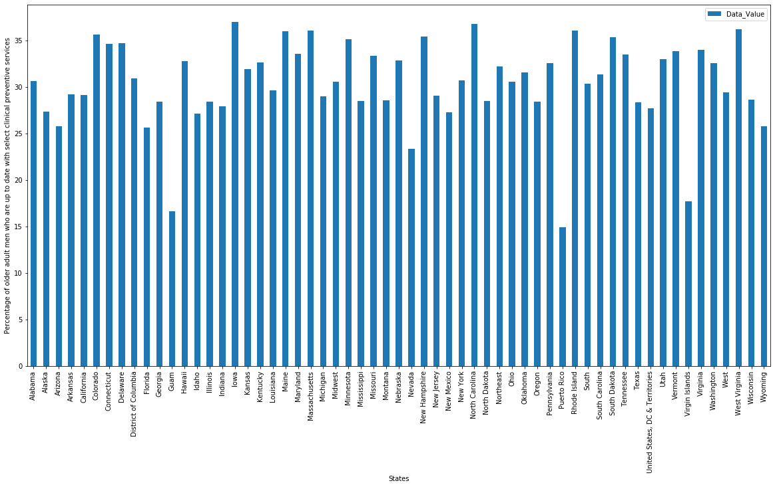
Graphs

Slide 5
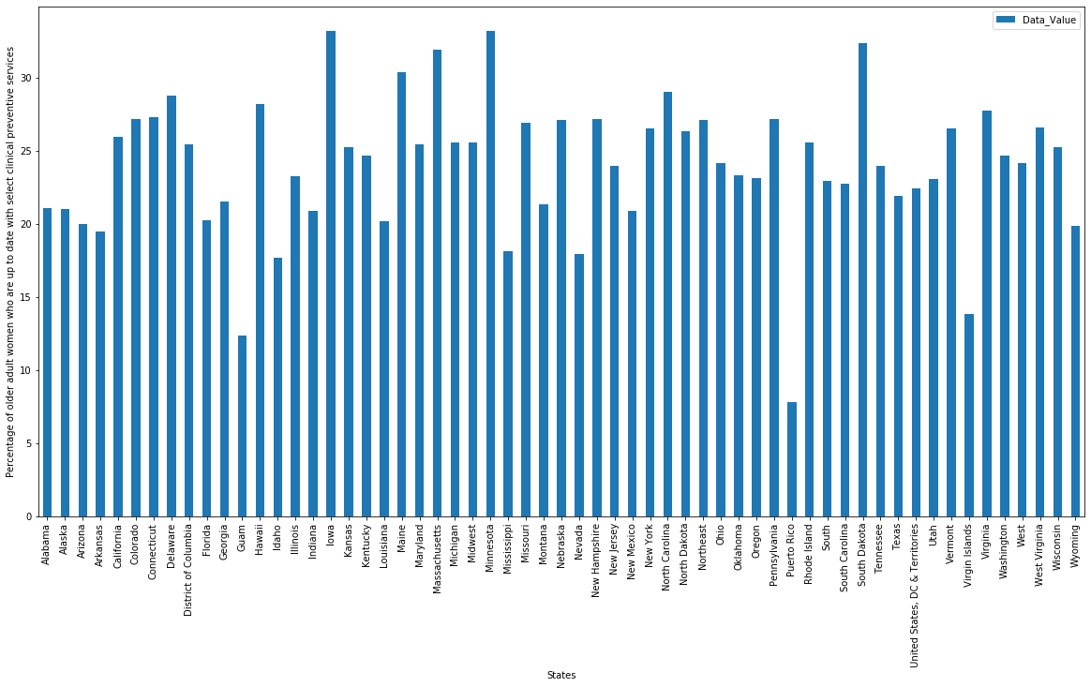
Graphs

Slide 6
Graph 1 and 2 analysis
Questions 1 and 2 are as follows:
Percentage of older adult men who are up to date with select clinical preventive services
Percentage of older adult women who are up to date with select clinical preventive services
The question to answer here is: are men or women more up to date with select clinical preventive services?

Slide 7
Graph 1 and 2 analysis
For Question 1 and Question 2, I will run a t-test to see whether the overall mean of Question 1[ Percentage of older adult men who are up to date with select clinical preventive services] is significantly different from the overall mean of Question 2[Percentage of older adult women who are up to date with select clinical preventive services].

Slide 8
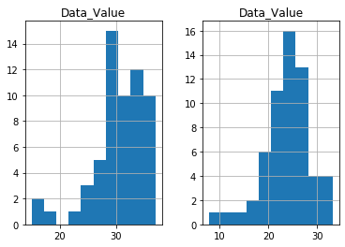
Graph 1 and 2 analysis
MEN
WOMEN

Slide 9
Graph 1 and 2 analysis
p-value is: 1.8730017536938703e-10 t-statstic is: 6.989005625607615 The t-test indictated that overall, men are significantly more up to date with select clinical preventive services than women
The distributions for the 2 questions are roughly normally distributed, I can proceed with my t-test.
From the graphs, we can see that men has a bigger range than women, with the upper limit close to 40 for men whereas for women its barely over 30.
p-value: 1.8730017536938703e-10
t-statstic: 6.989005625607615
The t-test indicated that overall, men are significantly more up to date with select clinical preventive services than women

Slide 10
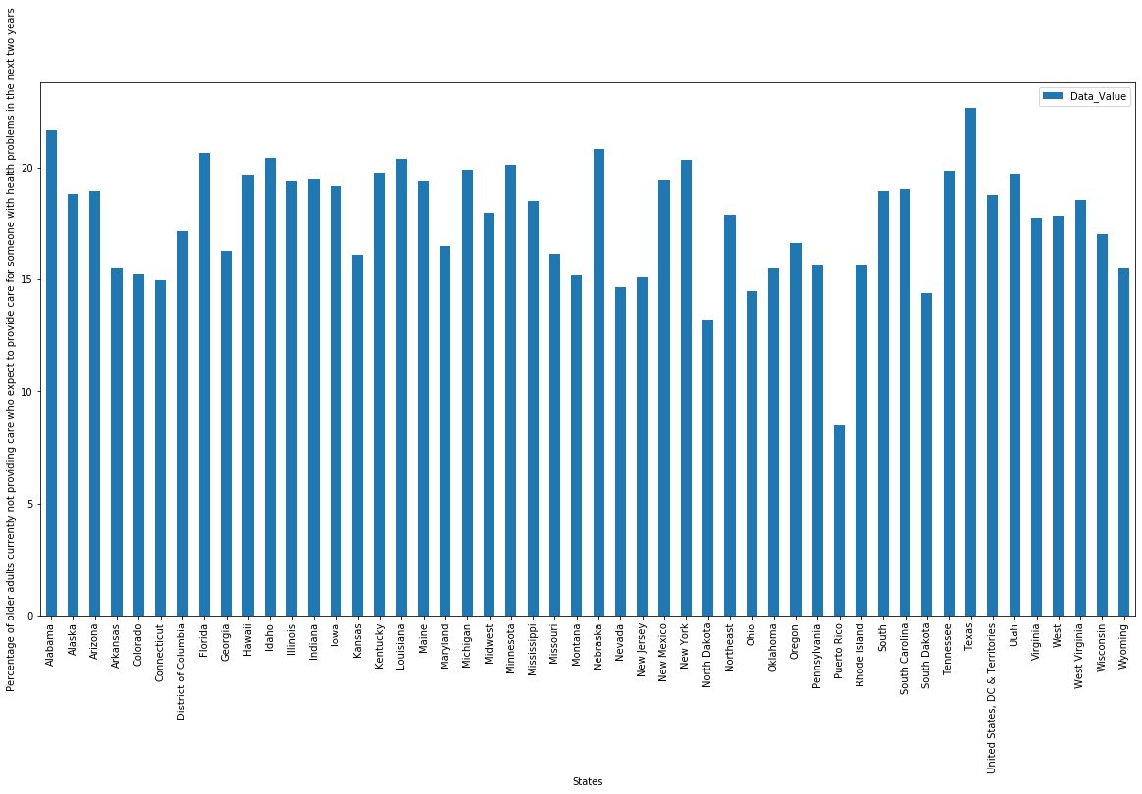
Graphs

Slide 11
Analysis
Not a significant difference between richer states such as New York and poor states such as Tennessee (both approximately has a value of 20). Only outlier is Puerto Rico with a percentage value of ~8. This is surprising, given that the data would suggest older adults currently not providing care in New York and Tennessee are about 3 times as likely as older adults currently not providing care in Puerto Rico to provide care for someone with health problems in the next two years.
Give the population in each state as:
New York - 19,453,561, Tennessee - 6,833,174, Puerto Rico - 3,193,694,
In the case of New York it can be argued that give it's population is 6.3 times more than that of Puerto Rico, you can expect a much higher number of older adults needing to care for others. In rural Tennessee, this can be explained by the fact that while the population is only ~2 times more than that of Puerto Rico, it is also a very poor state (15% poverty rate vs 14.1% in New York and 44.4% in Puerto Rico). Tennessee being poor could result its older adults being 3 times as likely as older adults currently not providing care in Puerto Rico to provide care for someone with health problems in the next two years with only a 2 times bigger population.
Finally one interesting fact is that, despite the extreme poverty rate in Puerto Rico, only about 8 percent of its older adults expect to care for someone in the next 2 years. The death rate between all 3 locations are relatively similar so I cannot explain this (782.7 in New York vs 1043.7 in Tennessee vs 922.2 in Puerto Rico).

Slide 12
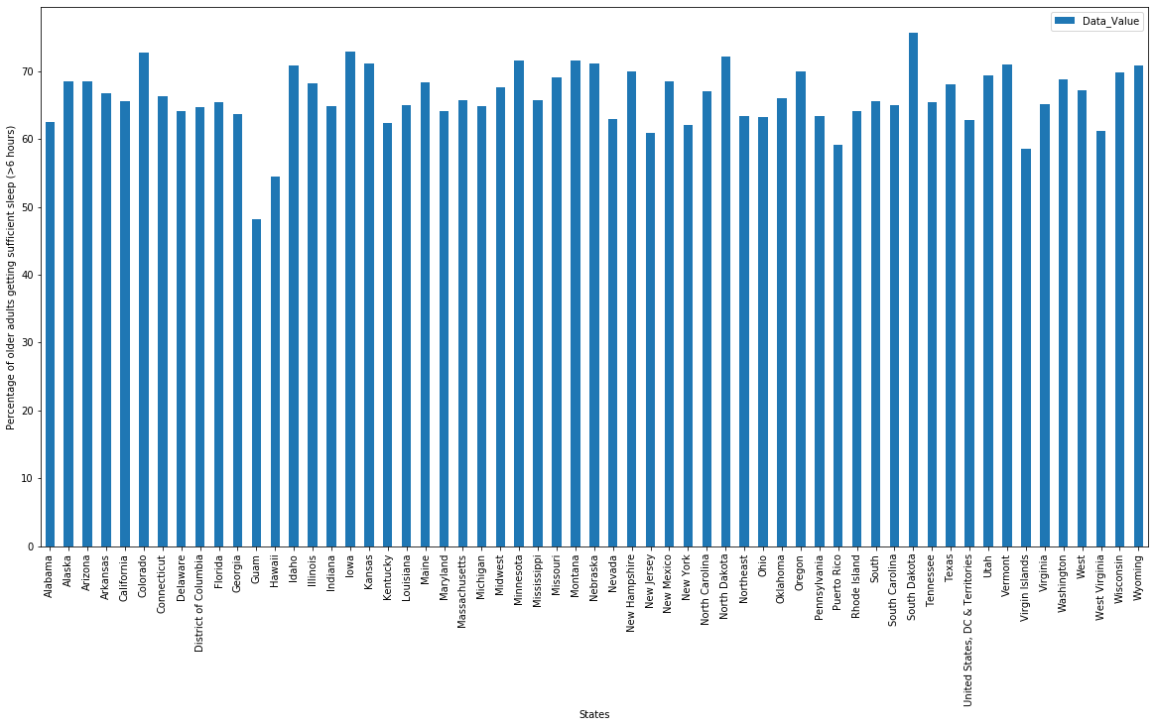
Graphs

Slide 13
Analysis
Only interesting point to point out here is that < 50% of older adults in Guam are getting less than 6 hours of sleep. This is less than even Virgin Islands with both locations having a comparable poverty rate (~22.9 for Guam vs 22.4 for Virgin Islands). Not sure how to explain this other than the presence of the US military base could affect the hours of sleep older adults get (due to noise from military operations on a very small island).
Another reason could be that, being a small island there is more pressure to work to make ends meet, therefore older adults may have to work longer hours as they are no longer in their prime, for the kind of work available on these islands (service industry mostly).

Slide 14
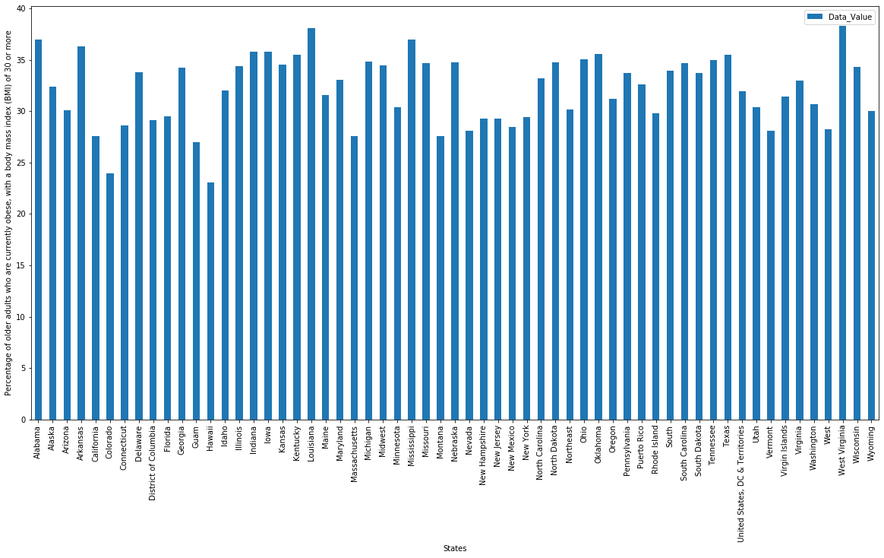
Graphs

Slide 15
Analysis
Overall at least 25% of older adults are obese, this is no surprise, America is fast food nation. There are differences between the states, but it is hard to attribute them to one or two factors - local economy, health awareness, weather can all attribute to the obesity. The differences are due to a variety of factors but overall, the data lies around a mean obesity percentage of around 30. Even among the more health conscious states like California, Washington the percentage is around 30. This suggests that overall, 3 out of 10 older Americans are obese no matter where you go.

Slide 16
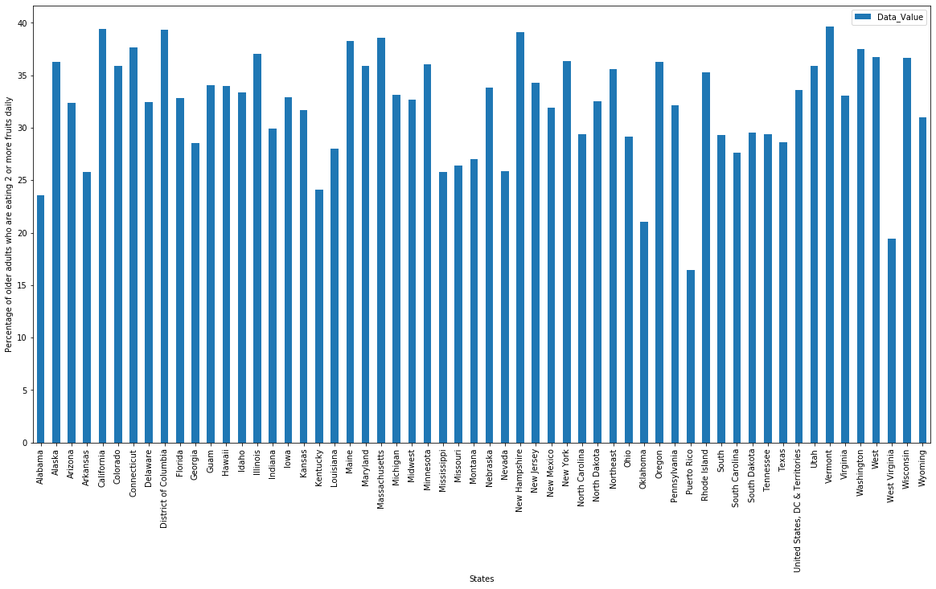
Graphs

Slide 17
Analysis
It is very interesting that while in Guam, older adults are getting plenty of fruits (35%), in Puerto Rico and Virgin Islands, a much less percentage of older adults are getting 2 or more fruits daily. This is surprising given the fact that Virgin Islands have the same poverty rate as Guam, yet much less older adults in Virgin Islands are eating less fruits than Guam - them both being island nations. Even their populations are similar (104914 for Virgin Islands and 165718 for Guam). It is possible that the presence of the US military base might benefit the locals as the presence of the US military could result in a surplus of fruits which could then be passed on to the locals (remember, the question doesn't tell the quality of fruits, just that, they are fruits).

Slide 18
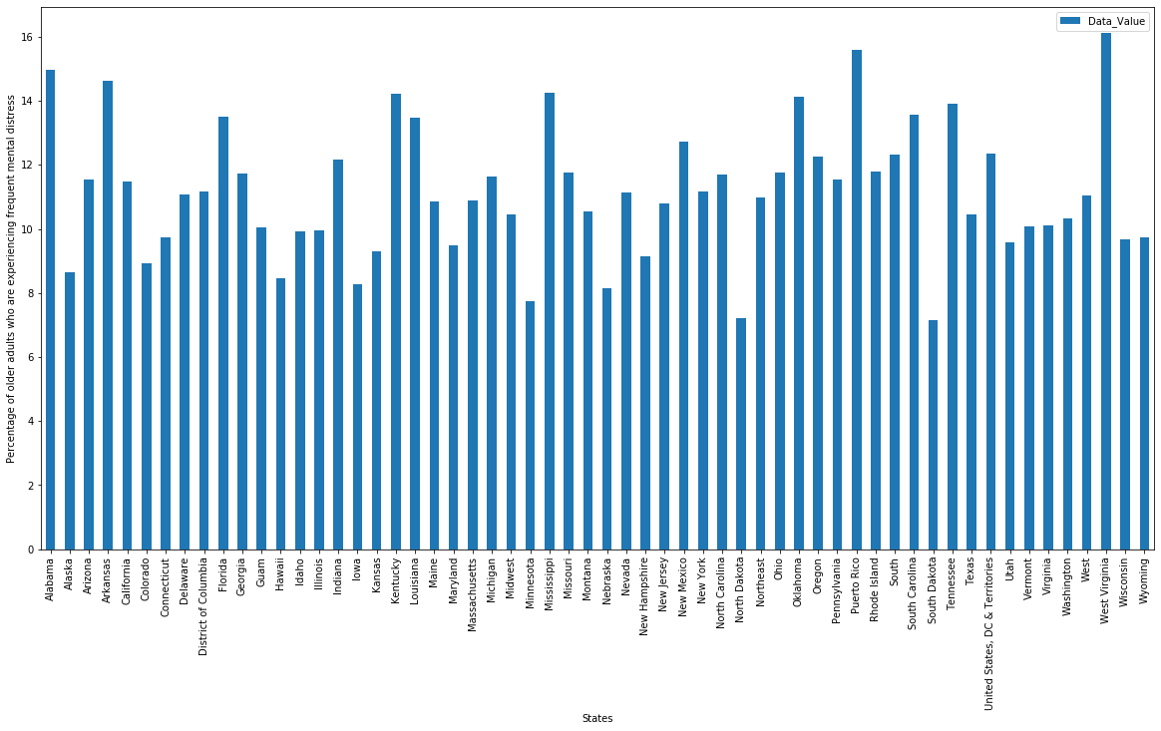
Graphs

Slide 19
Analysis
For some reason older adults in US Virgin Islands experiences the highest mental distress, despite Guam with a similar economy and population experiences much less stress. Obesity could be a reason possibly - almost 40% of the older adults in US Virgin Islands are obese. Being obese not only cause physical stress, but the loss in financial opportunities and lower self-esteem can also cause mental distress, especially given that on US Virgin Islands, large families is not uncommon.

Slide 20
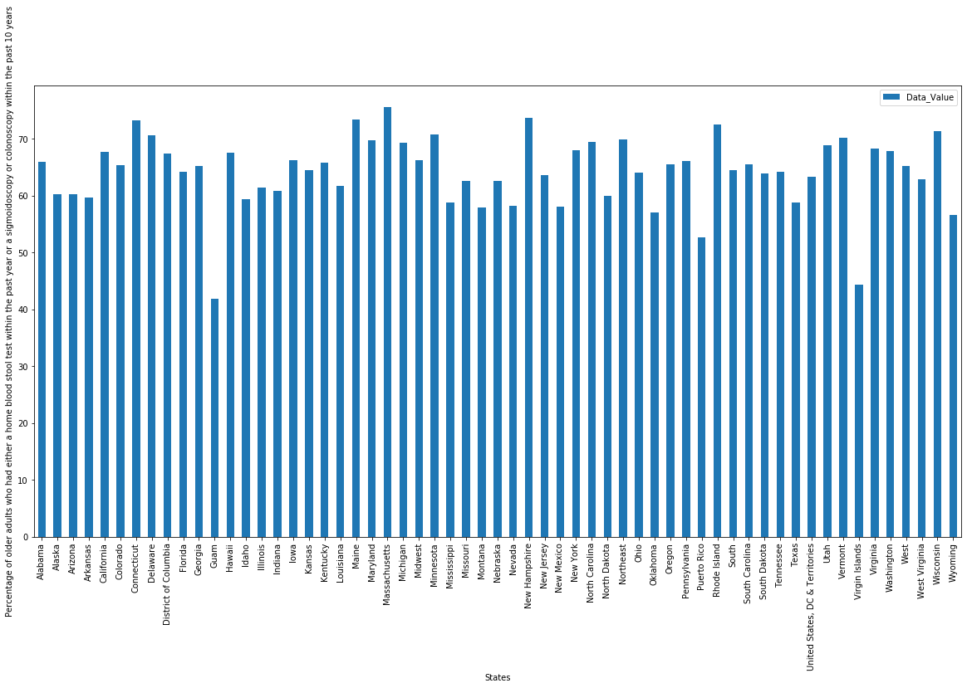
Graphs

Slide 21
Analysis
The two outliers, Guam and US Virgin Islands, could be attributed to poor economy, as high poverty rate means less people are getting their stool samples checked. Having a colonoscopy is neither pleasant nor cheap, especially on outlying islands with limited access to US mainland.

Slide 22
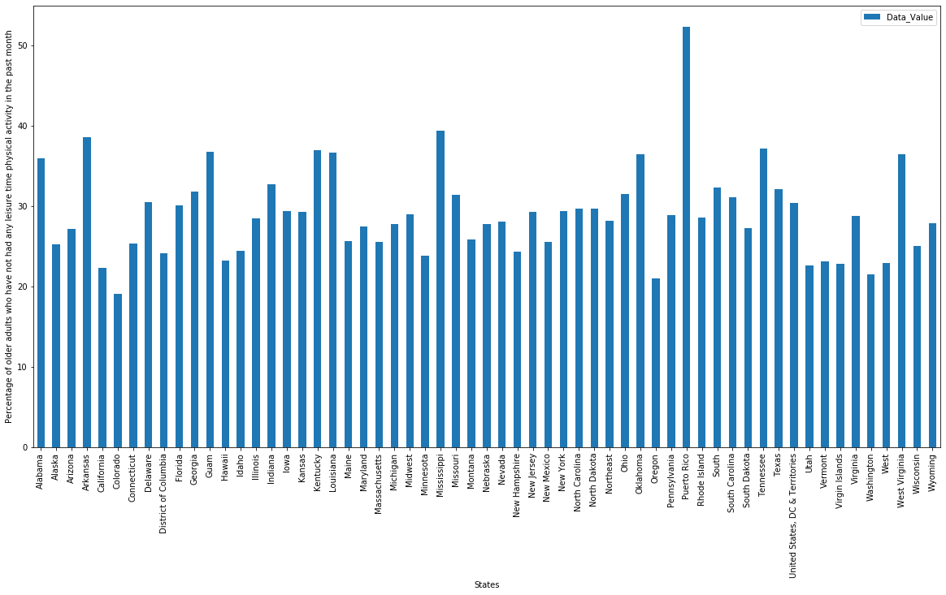
Graphs

Slide 23
Analysis
Very interesting to see over half of the older adults in Puerto Rico don't have leisure time. It is possible that the 44.4% poverty rate is a big factor - if half of the island is in poverty, that means their older relatives could not relax and enjoy retirement but rather must work or help with making ends meet.

Slide 24
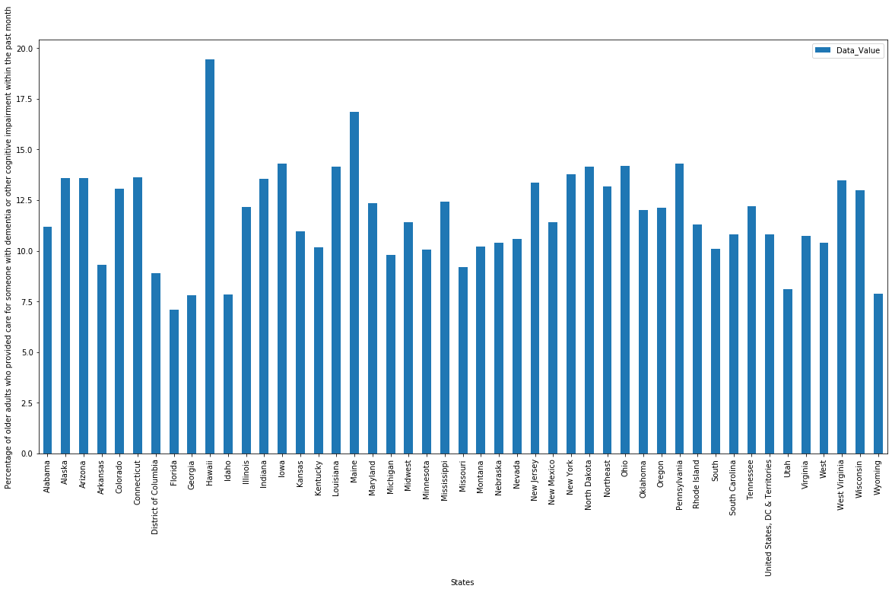
Graphs

Slide 25
Analysis
This data is interesting because it suggest that almost 20% of older adults in Hawaii were caring for someone with mental disease. However, give that it is a tourist destination, it is interesting Hawaii would have such a high incidence of mental illness. It only has a 9.5% poverty rate, which is among the lowest in the US.

Slide 26
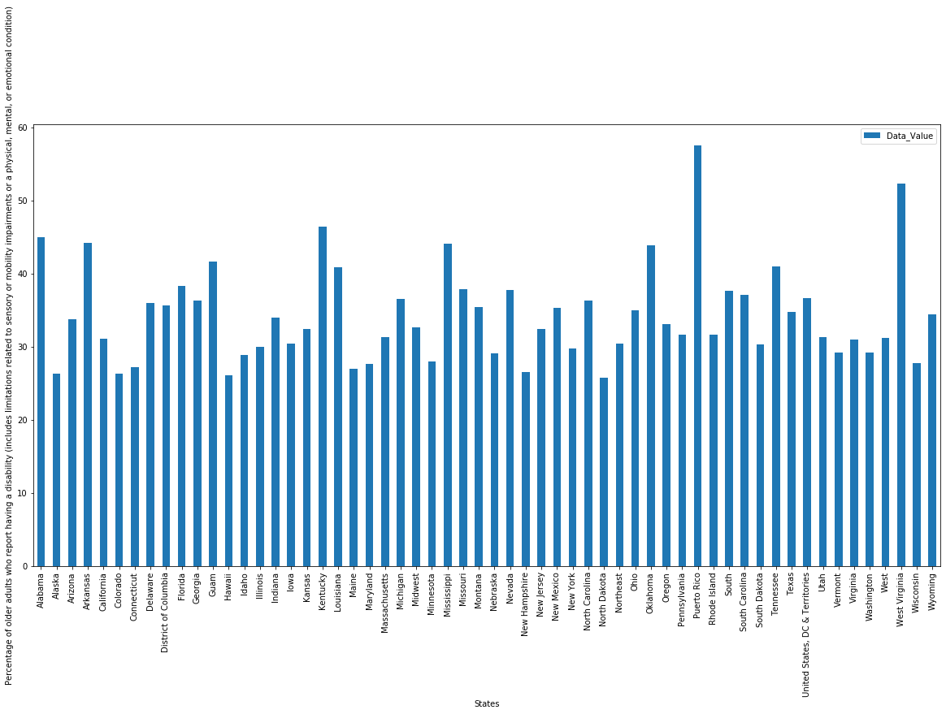
Graphs

Slide 27
Analysis
Very interesting to see that while older adults in Hawaii has a high incidence of mental disability, Puerto Rico and West Virginia has the highest physical disabilities. Puerto Rico I can understand given it's third world condition, but it is very interesting to see a mainland US state has over 50% of its older adults in physical disability - with only 10% of its population being veterans (so they cannot explain the 50% physical disability rate in West Virginia).

Slide 28
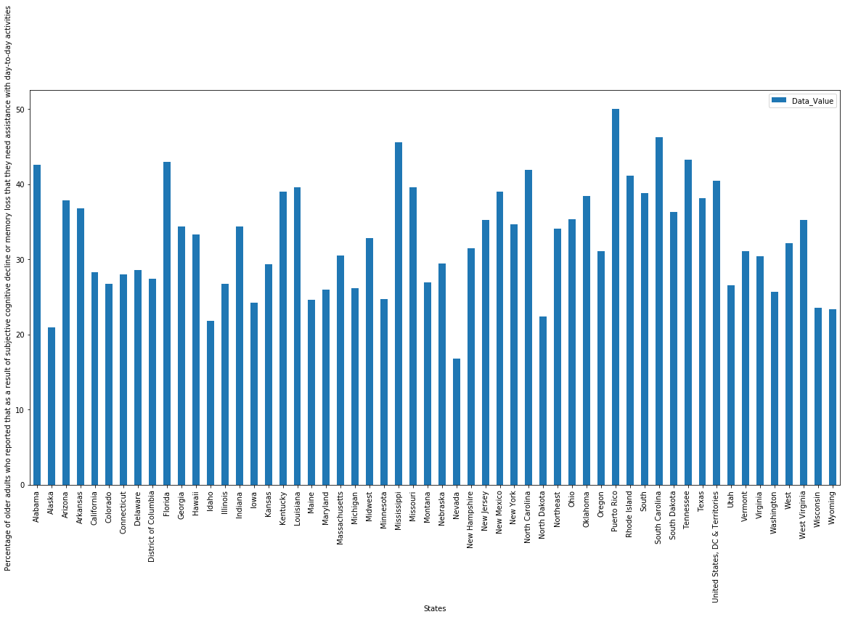
Graphs

Slide 29
Analysis
Very interesting that Hawaii has the highest percentage of older adults who provided care for someone with dementia or other cognitive impairment within the past month, it is among average for percentage of older adults who reported that as a result of subjective cognitive decline or memory loss that they need assistance with day-to-day activities. These two seems to contradict each other. Maybe older adults in other locations don't tend to provide care for someone with dementia or other cognitive impairment within the past month and leave it mainly up to the professionals?

Slide 30
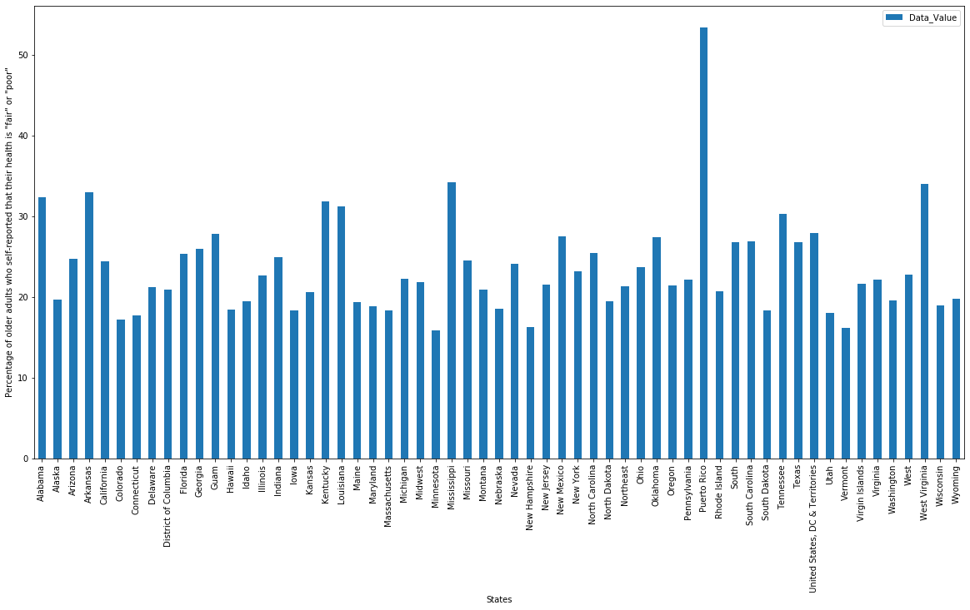
Graphs

Slide 31
Analysis
This graph makes sense, it is no surprise that Puerto Rico, with its 44.4% poverty rate, has over half of older adults rating their health as fair or poor. What is a surprise is that there is such a big difference between Puerto Rico, Guam and US Virgin Islands - they are among the 3 poorest US locations, yet their percentage of older adults who self-reported that their health is "fair" or "poor" is so much different.

Slide 32
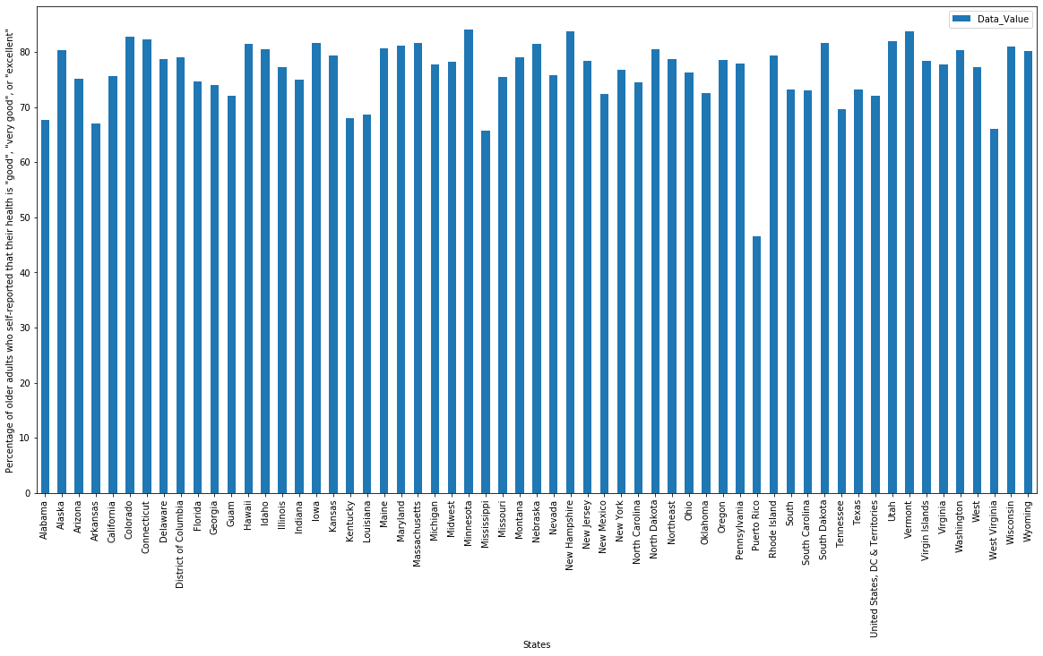
Graphs

Slide 33
Analysis
Apparently older adults in most every US locations think they are in good health except Puerto Rico. Local economy and access to health care could be a major factor, but interestingly these in U.S. Virgin Islands think they are in great health even though their local economy and health care is terrible.

